Slide 1

Module 4 Azure Active Directory
Azure AD Connect
Section 2 - Directory Synchronization
June 2018

Slide 2
Agenda – Module 4 - Section 2 – Directory Synchronization
01
Directory Sync Overview
02
Object Properties of Interest
03
Azure AD Connect Concepts
04
Password Synchronization
05
Password Write-back Synchronization

Slide 3
Why to synchronize
Allows to Integrate on-premises directories with Azure Active Directory
makes users more productive by providing a common identity for accessing both cloud and on-premises resources.
Users and organizations can take advantage of the following:
Users can use a single identity to access on-premises applications and cloud services such as Office 365.
Single tool to provide an easy deployment experience for synchronization and sign-in.
Provides the newest capabilities for your scenarios. Azure AD Connect replaces older versions of identity integration tools such as DirSync and Azure AD Sync. For more information, see Hybrid Identity directory integration tools comparison.
Notes:
https://docs.microsoft.com/en-us/azure/active-directory/connect/active-directory-aadconnect

Slide 4
Synchronization Landscape
Important : Synchronization = Provisioning + long-term consistency/parity of state between source objects (AD) and their representation in the external system (Azure AD).
ON-PREM
IDENTITY BRIDGE
MICROSOFT CLOUD
SAAS APPS
Azure AD
Google
Box
Salesforce
Others
AD DS
DirSync
AAD Sync
Azure AD Connect
- Sync
- Federation (ADFS)
- Sync & Fed Health
MIM/FIM+Connector
Cloud Sync Fabric
Back/Forward Sync
Identity Manager
HR
Tenant forests for EXO, LYO, SPO, CRMO, etc.
Other Apps
Notes:
Old Sync clients---Dirsync and AADSync :
Marked deprecated as of April 2016
No longer supported as of April 2017
No improvements being made to these clients

Slide 5
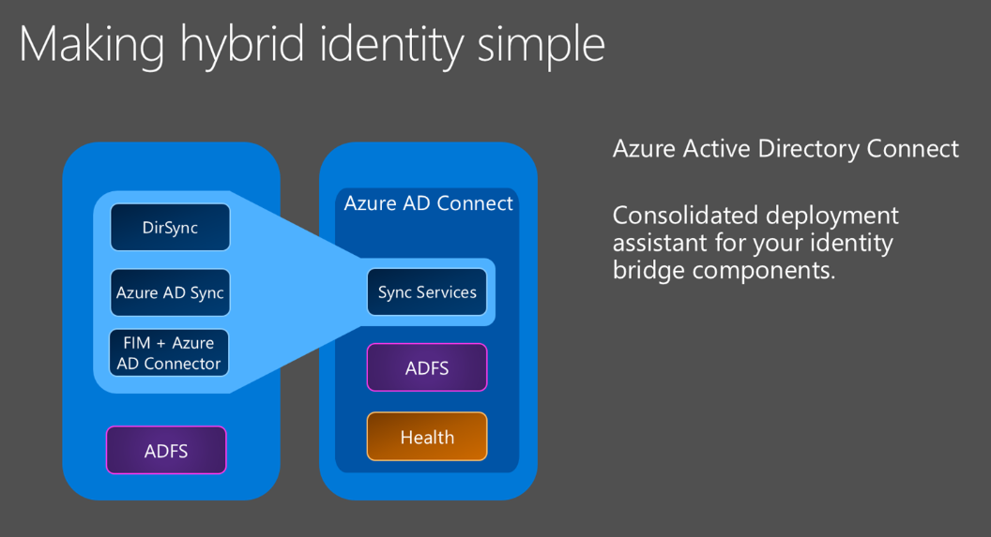
How do we synchronize ?
Via “Azure AD Connect” tool
Primary tool to onboard to Azure AD
Synchronize multi-forest Active Directory environments to Azure AD
Advanced provisioning, mapping and filtering rules for objects and attributes
Configuring multiple on-premises Exchange organizations to map to a single AAD tenant
Password Write Back (AAD Premium licence)
Required for both Synchronized (managed) and Federated models
Only one Azure AD Connect (effective synchronization) instance per Azure AD instance!
Can configure ADFS as well
DirSync ➔ Azure AD Sync (➔ deprecated) ➔ Azure AD Connect
FIM/MIM + Azure AD Connector (➔deprecated) ➔ Azure AD Connect
Notes:
Azure AD Connect is the Primary tool to onboard to Azure AD
Express settings gets customers connected in a matter of minutes
Provides install & configuration of password sync/ADFS for sign-in
All future investments will only be available with Azure AD Connect
Directory Integration Tools
https://azure.microsoft.com/en-us/documentation/articles/active-directory-aadconnect/
https://msdn.microsoft.com/en-us/library/azure/dn757582.aspx
Self-service password reset: how to customize password reset to meet your needs
https://msdn.microsoft.com/en-us/library/azure/dn688249.aspx
http://blogs.technet.com/b/ad/archive/2014/04/21/new-sync-capabilities-in-preview-password-write-back-new-aad-sync-and-multi-forest-support.aspx
Preview Self Service Password Reset writeback to Windows Server AD using DirSync
we've added a preview of DirSync password writeback for Self Service Password Reset. This capability allows customers who rely on federation or password hash sync to use Azure AD Premium to reset on-premises passwords in Windows Server Active Directory.

Slide 6
Azure AD Connect
3 main sub-components :
Identity Sync engine
Create users, groups and devices sync attributes to the cloud, write-back attributes/objects
Match identity information from on-premises and the cloud
Synchronize Password Hashes, write-back passwords
AD FS - Federation is an optional part of Azure AD Connect
Azure AD Connect can Deploy and/or configure AD FS
Health Monitoring
Provide health monitoring for both Azure AD Connect (“The Sync”) and AD FS
1
2
1
3
2
3
Keep in mind that Azure AD Connect engine is more than just a synchronization engine
Manages user sign-in options
Write-back for password, devices and groups
Tools to support AD FS
Simple UI experience to update AD FS SSL certificates
Fix Federation trust
Login testing
Azure AD Connect Health agent, reports status to the Azure AD Connect Health Portal
Notes:
See https://azure.microsoft.com/en-us/documentation/articles/active-directory-aadconnect/
Azure AD Connect engine is more than just a synchronization engine
Manages user sign-in options
Write-back for password, devices and groups
Tools to support AD FS
Simple UI experience to update AD FS SSL certificates
Fix trust
Login testing
Azure AD Connect Health agent, reports status to the Azure AD Connect Health Portal

Slide 7
On-premises objects synchronisation
Other directories
Windows Server
Active Directory
➔
Synchronise users, groups and devices (Requires an immutable ID)
Azure AD Connect
On-Premises
⬅ Enable write-back for passwords, devices and groups
Microsoft Azure Active Directory
Objectid (by default) as immutable id
sourceAnchor

Slide 8
Azure AD Connect
Azure AD Connect
Azure AD account to access Azure AD
(aadc-svc-ga@contoso.onmicrosotf.com)
AD account to access AD
Sync Engine ++
Microsoft Azure Active Directory
Service account to run Azure AD Connect
SQL Server 2012 Express LocalDB or
SQL Server 2008 or higher
Continuously evolving product : Automatic upgrades are possible (Set-ADSyncAutoUpgrade)
Azure AD Connect is a tool that’s been evolving at a fast pace.
It’s challenge to keep this content up to date/complete. Please refer to the online documentation for the latest and most accurate information.
Notes:
$cred = get-credential Note When you're prompted, enter your cloud service admin credentials.
Connect-MSOLService -credential $cred
(Get-MSOLCompanyInformation).DirectorySynchronizationEnabled Note This cmdlet returns a value of either True or False. If it returns a value of True, directory synchronization is activated. If it returns a value of False, directory synchronization is deactivated.

Slide 9
Azure AD Connect / key object “properties”: Source Anchor
It’s important to understand SourceAnchor ((aka ImmutableID ) :
Immutable in Azure AD
Used as the immutable identifier for any given object that is synchronized between on-premises and Azure AD
Unique identifier based on AD ObjectGUID (by default ! )
Basis for the relationship between AD DS objects and Azure AD objects.
AAD Connect defaulted to using ObjectGUID
April release of AAD Connect now uses msDS-ConsistencyGuid
AAD Connect writes its objectGUID value to the msDS-ConsistencyGuid attribute
* Only if msDS-ConsistencyGuid is NULL
Allows a user to move between forests without creating a duplicate in Azure AD
We refer to this as the “ConsistencyGUID”
AD ObjectGUID or msDS-ConsistencyGuid
SourceAnchor
(Dirsync Metaverse)
SourceAnchor
(immutable in) Azure AD
Notes:
https://azure.microsoft.com/en-us/documentation/articles/active-directory-aadconnect-design-concepts/
From the latest version of AzureADConnect released in May 2017
Azure AD automatically configures the sync rules to use msDS-ConsistencyGuid as the sourceAnchor attribute for User objects
if msDS-ConsistencyGuid attribute isn't populated on-prem
AADC stamps its ObjectGUID to msDS-ConsistencyGuid on-prem
then exports the object to Azure AD
the following logic is used to determine the sourceAnchor:
First, AADCwizard queries Azure AD for the sourceAnchor attribute used previously (if any). If available, uses the same AD attribute.
If not, the wizard checks the state of the msDS-ConsistencyGuid attribute on-prem.
If the attribute isn't configured on any object in the directory, the wizard uses the msDS-ConsistencyGuid as the sourceAnchor attribute.
If the attribute is configured then it will not be used as sourceAnchor and falls back to using objectGUID

Slide 10
Azure AD Connect / key object “properties”: UPN
User Principal Name (UPN) Alignment
Define a UPN strategy prior to syncing
Align UPN=SMTP=SIP for the best end user experience
Don’t use Alternate Logon ID (not recommended)
If missing, is constructed as: sAMAccountName + “@” + <tenantname>.onmicrosoft.com
Required for Federated Domain (federated identities)
UPN must be unique in the Active Directory Forest
Domain must be registered as alternate UPN suffix in Active Directory
UPN suffix must be assigned to any user authenticating through federated authentication
Critical for successful single sign-on using AD FS
Note: You can use alternate loginID, (In case where UserPrincipalNames are using a non-routable domain), but beware, it is not supported in Exchange Hybrid Environment.
See: http://social.technet.microsoft.com/wiki/contents/articles/24096.dirsync-using-alternate-login-ids-with-azure-active-directory.aspx
2 main configuration actions are needed:
Change the synchronization attribute flow for UserPrincipalName for provisioning/sync
Leverage the Alternate Login ID feature of AD FS for Single Sign-On authentication : Set-AdfsClaimsProviderTrust -TargetIdentifier "AD AUTHORITY" -AlternateLoginID mail -LookupForests contoso.com, fabrikam.com
Notes:
You can also use alternate loginID, but beware, it is not supported in Exchange Hybrid Environment.
For information about using alternate login IDs with AAD, see: http://social.technet.microsoft.com/wiki/contents/articles/24096.dirsync-using-alternate-login-ids-with-azure-active-directory.aspx

Slide 11
Azure AD Connect : Source of Authority
Refers to the location where Active Directory objects are mastered (AD on-premises or Azure AD)
Activating and installing AAD Connect makes the on-premises Active Directory the source of authority
Once enabled, changes to objects replicated to Azure AD can only be made on-premises
Deactivating AAD Connect (in the Admin portal) transfers the source of authority back to the Azure Active Directory

Slide 12
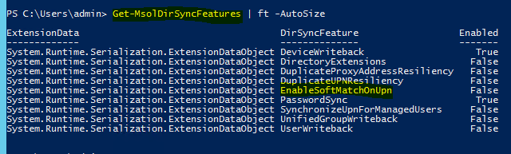
Azure AD Connect : « Hard Match vs. Soft Match »
During attribute sync updates, the AAD “Admin Web Service” component must identify what Azure Active Directory object to act upon:
HardMatch attempted first:
Checks to see if the object already exists with the same SourceAnchor value (ObjectGUID by default) from the on-premises AD
SoftMatch if no hard match found:
Authoritatively matches an object in Azure AD with AD on-premises through a matching ProxyAddresses value
If a match exists, stamp the ObjectGUID (by default) from AD on-premises as base64-encoded SourceAnchor attribute in Azure AD Connect Sync Database
SourceAnchor flows into Azure Active Directory object’s ImmutableID, allowing Source Of Authority Transfer from Azure AD to AD on-premises
UserPrincipalName soft match if no soft match found:
Allows objects to join on userPrincipalName in addition to primary SMTP address .
particularly useful if you need to match on-premises AD accounts with already existing accounts created in the cloud (and you are not using Exchange Online)
Enable by default : Set-MsolDirSyncFeature -Feature EnableSoftMatchOnUpn -Enable $true
https://azure.microsoft.com/en-us/documentation/articles/active-directory-aadconnectsyncservice-features/

Slide 13
Azure AD Connect and Write-back (options)
Password write-back
Provide users Self Service Password Reset (SSPR) capabilities
Ability to reset passwords on-prem. (Password sync and Federation customers supported)
Group write-back
Office 365 groups written back as read-only DLs
Requires Exchange schema
Improves productivity in Hybrid scenarios (O365 groups appear in on-premises GAL)
Device write-back
Supports ability to do conditional access in AD FS based on registered devices
Share Azure DRS registered devices with (on-premise) Active Directory so that AD FS can leverage device authentication for these devices
Exchange Hybrid write-back
Notes:
https://docs.microsoft.com/en-us/azure/active-directory/connect/active-directory-aadconnect-get-started-custom
Azure AD Connect is a tool that’s been evolving at a fast pace. It’s challenge to keep this content up to date/complete. Please refer to the online documentation for the latest and most accurate information.

Slide 14
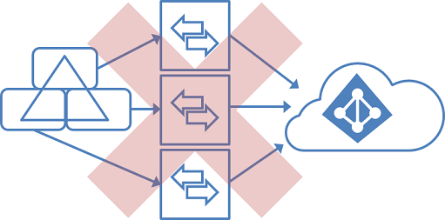
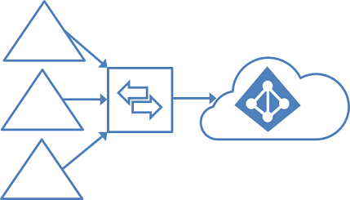
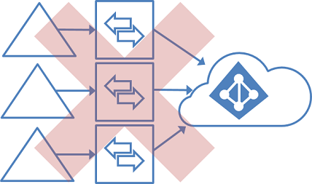
Azure AD Connect Topologies
Supported
Not Supported
Single Forest, multiple sync servers with one Azure AD Tenant: Not Supported
Single Forest with Single AAD Tenant using Azure AD Connect : supported
Multiple Azure AD Connect instances with one Azure AD Connect : not supported
Multiple Forests with Single Azure AD tenant using AAD Connect : supported
13
Notes:
For a full read on this topic: https://azure.microsoft.com/en-us/documentation/articles/active-directory-aadconnect-topologies/

Slide 15
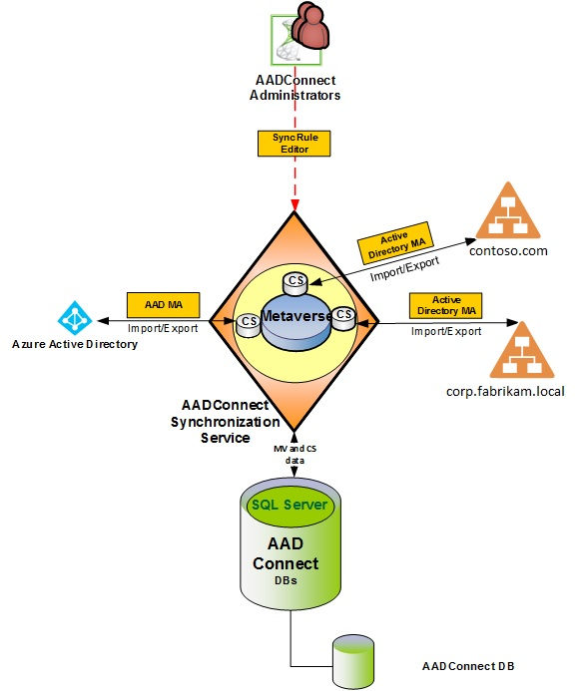
Azure AD Connect Concepts
Metaverse : Aggregate information about a managed object (i.e. User, Group, etc.)
A metaverse is a consolidated view of all the joined identities from neighboring connector spaces
Objects in a metaverse cannot be edited directly
Objects are created when an authoritative system projects them into the metaverse
All the data that is stored in an object must be contributed through an attribute flow. The metaverse maintains persistent connectors with every connector space
Connector Space
Each connected data source is represented as a filtered subset of the objects and attributes in the connector space. This allows the sync service to operate locally without the need to contact the remote system when synchronizing the objects and restricts interaction to imports and exports only
When the data source and the connector have the ability to provide a list of changes (a delta import), then the operational efficiency increases dramatically as only changes since the last polling cycle are exchanged
The connector space insulates the connected data source from changes propagating automatically by requiring that the connector schedule imports and exports This added insurance grants you peace of mind while testing, previewing, or confirming the next update
Notes:
https://docs.microsoft.com/en-us/azure/active-directory/connect/active-directory-aadconnectsync-technical-concepts
Connector Space:
Replica of the managed objects (holograms) in the Active Directory
Each management agent or connector has its own connector space
Metaverse:
Aggregate information about a managed object (i.e. User, Group, etc.)

Slide 16
Azure AD Connect Concepts
Connector
The code modules that are used to communicate with a connected data source are called Connectors (formerly management agents (MAs))
Connectors are installed on the computer running AADConnect
The Connectors provides the agentless ability to converse by using remote system protocols instead of relying on the deployment of specialized agents. This means decreased risk and deployment times, especially when dealing with critical applications and systems
The connector is responsible for all import and export functionality to the system
Imports and exports only occur when scheduled, allowing for further insulation from changes occurring within the system, since changes do not automatically propagate to the connected data source.

Slide 17
Azure AD Connect Concepts
Attribute flow
The metaverse is the consolidated view of all joined identities from neighboring connector spaces.
Attribute flow is the process of copying or transforming data from one system to another and all attribute flows (inbound or outbound)
Attribute flow occurs between the connector space and the metaverse bi-directionally when synchronization (full or delta) operations are scheduled to run
Attribute flow only occurs when these synchronizations are run. Attribute flows are defined in Synchronization Rules.

Slide 18

Azure AD Connect : Synchronization principle
AADConnect
AD Management Agent
Contoso
AD
Metaverse
3
Microsoft Azure Active Directory Sync Management Agent
2
Contoso.com
AD Management Agent
Fabrikam
AD
contoso.mail.onmicrosoft.com
Exchange
Azure AD Connect imports from connected directories to Connector Space
Azure AD Connect synchronizes to Metaverse
Azure AD Connect uses attribute mapping to determine the type of object to provision or update
Azure AD Connect exports and/or revises the objects to the connected directories
corp.fabrikam.local
Notes:
AAD Connect uses at least two managements agents:
“Active Directory Connector” management agent
“Windows Azure Active Directory” management agent
AAD Connect stores information in two places:
Per Connector Space
Metaverse : Central repository of Aggregate data/object

Slide 19
Synchronization principles process : Staging / Sync / Import / Export
Metadirectory
Connector Space
Azure AD
Export
Microsoft Azure Active Directory
Metaverse
Synchronization
Connector
Space
AD DS
Import
Windows Server
Active Directory
Notes:
The synchronization service divides object processing into three major steps:
Staging
The process of importing objects from a connected data source into the connector space.
Synchronization
The process of applying all the configured rules to the staged objects in the connector space.
Export
The process of writing changes that occurred during synchronization from the connector space to the connected data source.
These steps can be activated individually by using the FIM run profiles. These run profiles contain at least one of these run steps, which FIM the performs when a run profile is invoked. For example, you could have a run profile that only runs the staging step.
It is important to note that the synchronization step applies all rules starting with the connector space objects managed by the MA concerned, through the metaverse, and all the way through to the other connector spaces (including the originating connector space object if the changes need to flow back).
This means that synchronization calculates all the changes on all connector spaces that are to be applied during an export. The export run step then applies the calculated changes to the connected data source.

Slide 20
Synchronization data flow & key terms
(source) CONNECTOR SPACE
METAVERSE
(target) CONNECTOR SPACE
CONNECTOR
AD DS
INBOUND SYNC RULE
Microsoft Azure Active Directory
Replica X
CONNECTOR
Object X
OUTBOUND SYNC RULE
Connected directories
CONNECTOR
Hologram/Replica Y
Run Profiles and Steps:
Full Import Delta Import Full Synchronization Delta Synchronization Export
Aggregate XY
Aggregate XY
AD DS
INBOUND SYNC RULE
(source) CONNECTOR SPACE
Object Y
Step Import ➔ replica creation
Step Synchronisation ➔ Projection || join (ops) in MV
Step Synchronisation ➔Provision
Step Export
Select containers/object type/attributes to import (@ CS properties)
Export
sync
sync
Import
19
Notes:
See https://docs.microsoft.com/en-us/azure/active-directory/connect/active-directory-aadconnectsync-understanding-architecture
User is imported from AD into the Active Directory Connector Connector space
User is projected to the Metaverse
User is provisioned to the Windows Azure Active Directory Connector space
User is exported to the Office 365 Admin Web Service
AADConnect Run Profiles
Full Import:
Performs a full import, but does not synchronize the changes with the metaverse
Objects are staged to the connector space
Delta Import
Imports only the changes
Does not synchronize changes with the metaverse
Full Synchronization
Synchronizes all the objects with the metaverse, including the objects that have not changed
Delta Synchronization
Synchronizes only the changes (deltas) with the metaverse
Export
Exports the changes to the target system

Slide 21
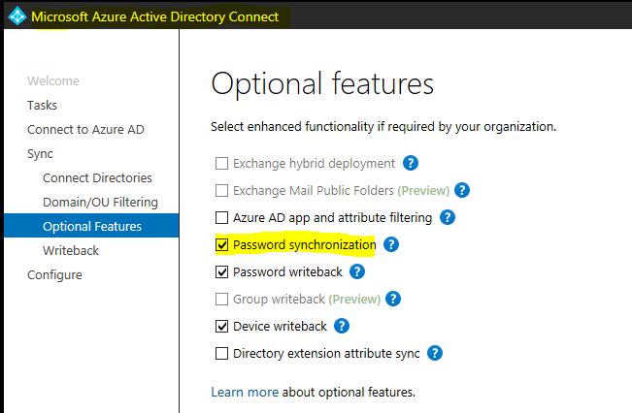
Password Sync Overview
Password Synchronization is the process of copying a customers on-premises password hash (hash of hash) to Azure Active Directory
Allows the customer to use their on-premises password to log into their Azure AD / Office 365
Password Synchronization does not replace Identity Federation
Changes to on-premises passwords are synced to the cloud in minutes.
If the user is currently logged into a cloud service with their old password, then change their password in the on-premises AD, their current cloud service session will continue uninterrupted
How to enable Password Synchronization
Select “Password Synchronization” in the configuration wizard of Azure AD Connect
Notes:
https://docs.microsoft.com/en-us/azure/active-directory/connect/active-directory-aadconnectsync-implement-password-hash-synchronization
Password hash synchronization is a feature used to synchronize user passwords from an on-premises Active Directory instance to a cloud-based Azure AD instance. Use this feature to sign in to Azure AD services like Office 365, Microsoft Intune, CRM Online, and Azure Active Directory Domain Services (Azure AD DS). You sign in to the service by using the same password you use to sign in to your on-premises Active Directory instance.

Slide 22
Password (Hash) Synchronization – some facts
Once enabled all in-scope user passwords are synchronized
Cannot apply password sync to a subset of users. Applies to all sync’d users.
Synchronizes a hash of the password hash
The actual password never leaves on-premises and is not known by Azure AD
When enabled, on premises password policies apply
Password complexity policy
Password expiration policy
Protects password against pass the hash attacks
The hash of the password hash cannot be used to access any on-premises resources
An locked out on-premises AD account can still be active in the cloud
The cloud password for a PHS user is set to never expire
A disabled on-premises AD account will not be reflected in Azure AD until the next sync cycle
Potentially 30 mins delay
Password Hash Sync (PHS) can be used in addition to federation and used as a fall-back

Slide 23
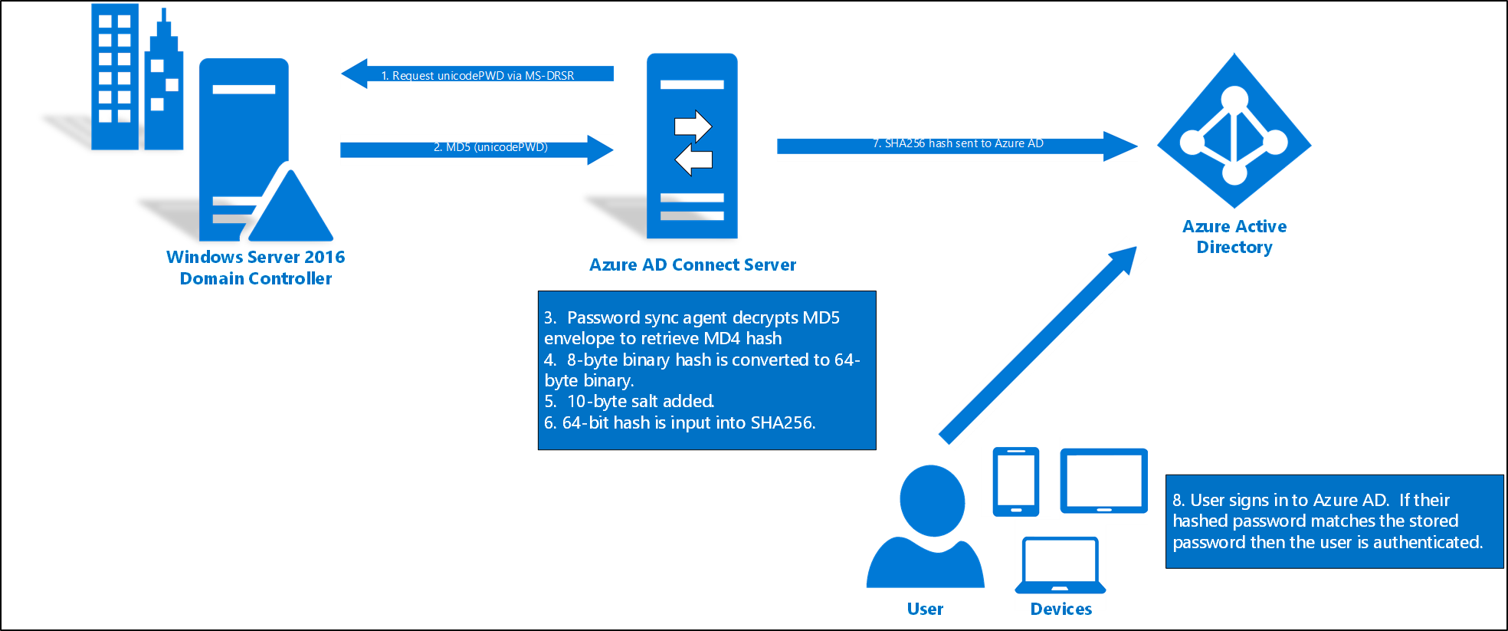
How password hash synchronization works
1. Request unicodePWD via MS-DRSR
Note
The original MD4 hash is not transmitted to Azure AD. Instead, the SHA256 hash of the original MD4 hash is transmitted. As a result, if the hash stored in Azure AD is obtained, it cannot be used in an on-premises pass-the-hash attack.
7. SHA256 hash sent to Azure AD
2. MD5 (unicodePWD)
Notes:
Reference : https://docs.microsoft.com/en-us/azure/active-directory/connect/active-directory-aadconnectsync-implement-password-hash-synchronization
Every two minutes, the password hash synchronization agent on the AD Connect server requests stored password hashes (the unicodePwd attribute) from a DC via the standard MS-DRSR replication protocol used to synchronize data between DCs. The service account must have Replicate Directory Changes and Replicate Directory Changes All AD permissions (granted by default on installation) to obtain the password hashes.
Before sending, the DC encrypts the MD4 password hash by using a key that is a MD5 hash of the RPC session key and a salt. It then sends the result to the password hash synchronization agent over RPC. The DC also passes the salt to the synchronization agent by using the DC replication protocol, so the agent will be able to decrypt the envelope.
After the password hash synchronization agent has the encrypted envelope, it uses MD5CryptoServiceProvider and the salt to generate a key to decrypt the received data back to its original MD4 format. At no point does the password hash synchronization agent have access to the clear text password. The password hash synchronization agent’s use of MD5 is strictly for replication protocol compatibility with the DC, and it is only used on premises between the DC and the password hash synchronization agent.
The password hash synchronization agent expands the 16-byte binary password hash to 64 bytes by first converting the hash to a 32-byte hexadecimal string, then converting this string back into binary with UTF-16 encoding.
The password hash synchronization agent adds a per user salt, consisting of a 10-byte length salt, to the 64-byte binary to further protect the original hash.
The password hash synchronization agent then combines the MD4 hash plus the per user salt, and inputs it into the PBKDF2 function. 1000 iterations of the HMAC-SHA256 keyed hashing algorithm is used.
The password hash synchronization agent takes the resulting 32-byte hash, concatenates both the per user salt and the number of SHA256 iterations to it (for use by Azure AD), then transmits the string from Azure AD Connect to Azure AD over SSL.
When a user attempts to sign in to Azure AD and enters their password, the password is run through the same MD4+salt+PBKDF2+HMAC-SHA256 process. If the resulting hash matches the hash stored in Azure AD, the user has entered the correct password and is authenticated.
Note
The original MD4 hash is not transmitted to Azure AD. Instead, the SHA256 hash of the original MD4 hash is transmitted. As a result, if the hash stored in Azure AD is obtained, it cannot be used in an on-premises pass-the-hash attack.

Slide 24


Microsoft Azure Active Directory
How password hash synchronization works – more details
Azure AD Connect
Sync Engine ++
0. MD4 hash of password exists and is stored in unicodePwd attribute
5. Password stored as “original MD4 after processing with salt + PBKDF2 + HMAC-SHA256”
1. Requests unicodePwd attribute values via MS-DRSR replication protocol
2. Encrypts MD4 with salt and MD5 hash of RPC session key
Sends result & salt
3. Decrypts to obtain MD4 hash of password
4. MD4 hash expanded, salt added input to PBKDF2 function 1000 interactions of HMAC-SHA256
Result sent to Azure AD
Note: The on-premises Azure AD Connect AD account requires AD permissions:
Replicate Directory Changes
Replicate Directory Changes All
7. Does supplied password value, after processing with MD4, with salt, PBKDF2 and HMAC-SHA256, match stored value for user?
6. Sign in
PBKDF = password based Key Derivation Function (RFC 2898)
Notes:
https://docs.microsoft.com/en-us/azure/active-directory/connect/active-directory-aadconnectsync-implement-password-hash-synchronization

Slide 25
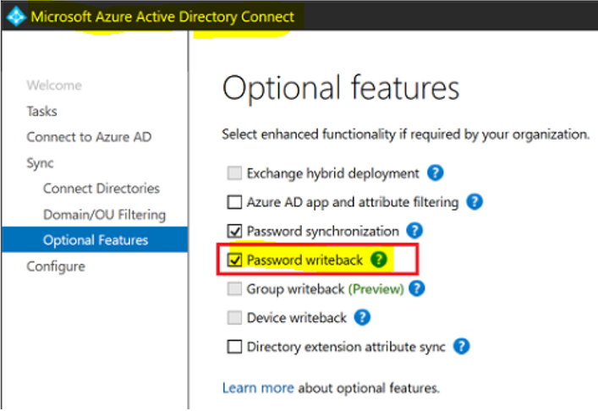
Password write-back
What is it
Allows a password (that is changed in the cloud) to be written back to on-premises
Convenient cloud-based way for your users to reset their on-premises passwords wherever they are.
This is required for the Self-service password reset feature (SSPR and password change)
Optional feature of Azure AD Connect (Part of Azure AD Premium edition)
How do I enable it
Turn-on the feature by selecting “Password writeback” in the configuration wizard of Azure AD Connect
When does it write back
Cloud authenticated (managed) user and password sync is enabled
On-premises SSO authenticated (federated) user
Security
All communication takes place over SSL
Registration of public/private key pairs for transport and encryption, you keep the private keys
On-premises authentication modes that are supported for password writeback:
Cloud-only users: Password writeback does not apply in this situation, because there is no on-premises password.
Password-synchronized users: Password writeback is supported.
Federated users: Password writeback is supported.
Pass-through Authentication users: Password writeback is supported.
Notes:
Password writeback overview https://docs.microsoft.com/en-us/azure/active-directory/authentication/howto-sspr-writeback#configure-password-writeback

Slide 26


Password Write-Back (Registration)
Admin turn on feature using: Turn-on the feature by selecting “Password writeback” in the configuration wizard of Azure AD Connect
Azure Active Directory
Public Key
Generate 3 sets of “keys”:
A random strong password for Authentication purpose of the Azure AD Connect on-premises agent.
The on-premises agent wakes up and authenticates to the service bus by using this strong password
A private/public pair for Password Encryption purpose
Password encryption with 2048-bit public RSA Key
Protect the end-to-end password transmission (from the Reset pwd page to the Azure AD connect on-prem agent)
A strong symmetric key
For protecting an entire package (the encrypted password plus the required metadata) that is sent to the tenant-specific service bus relay.
This encryption prevents anyone with direct access to the underlying ServiceBus channel from viewing or tampering with the contents.
This is encrypted by using AES-GCM.
Directory Sync Tool
Private Key
Windows Server Active Directory
Notes:
https://docs.microsoft.com/en-us/azure/active-directory/authentication/howto-sspr-writeback
Tenant specific service-bus relay – When you set up the service, we set up a tenant-specific service bus relay that is protected by a randomly generated strong password that Microsoft never has access to.
Locked down, cryptographically strong, password encryption key – After the service bus relay is created, we create a strong symmetric key which we use to encrypt the password as it comes over the wire. This key lives only in your company's secret store in the cloud, which is heavily locked down and audited, just like any password in the directory.

Slide 27


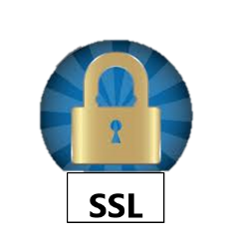



Password Write-Back (Write-back flow)
User resets password (in the cloud) using Self-Service Password Reset
Reset password = x
Azure AD encrypt the password using your tenant specific key that only you know how to decrypt
Azure Active Directory
f(x)
x
= f(x)
x
g(x)
Sync engine of Azure AD Connect is listening for password resets. It gets user identity and encrypted password.
It decrypts the password and sends it to your on-prem Active Directory. If password matches the on-prem password requirements, then user password is updated.
Azure AD Connect Sync Tool
x
Only after receiving success for on-prem write-back, we hash the password and store it in the cloud
Windows Server Active Directory
f(x)
= x
Notes:
https://docs.microsoft.com/en-us/azure/active-directory/authentication/howto-sspr-writeback
Password writeback encryption details
After a user submits a password reset, the reset request goes through several encryption steps before it arrives in your on-premises environment. These encryption steps ensure maximum service reliability and security. They are described as follows:
Step 1: Password encryption with 2048-bit RSA Key: After a user submits a password to be written back to on-premises, the submitted password itself is encrypted with a 2048-bit RSA key.
Step 2: Package-level encryption with AES-GCM: The entire package, the password plus the required metadata, is encrypted by using AES-GCM. This encryption prevents anyone with direct access to the underlying ServiceBus channel from viewing or tampering with the contents.
Step 3: All communication occurs over TLS/SSL: All the communication with ServiceBus happens in an SSL/TLS channel. This encryption secures the contents from unauthorized third parties.
Automatic key rollover every six months: Every six months, or every time password writeback is disabled and then re-enabled on Azure AD Connect. We automatically roll over all keys to ensure maximum service security and safety.

